Slide 1

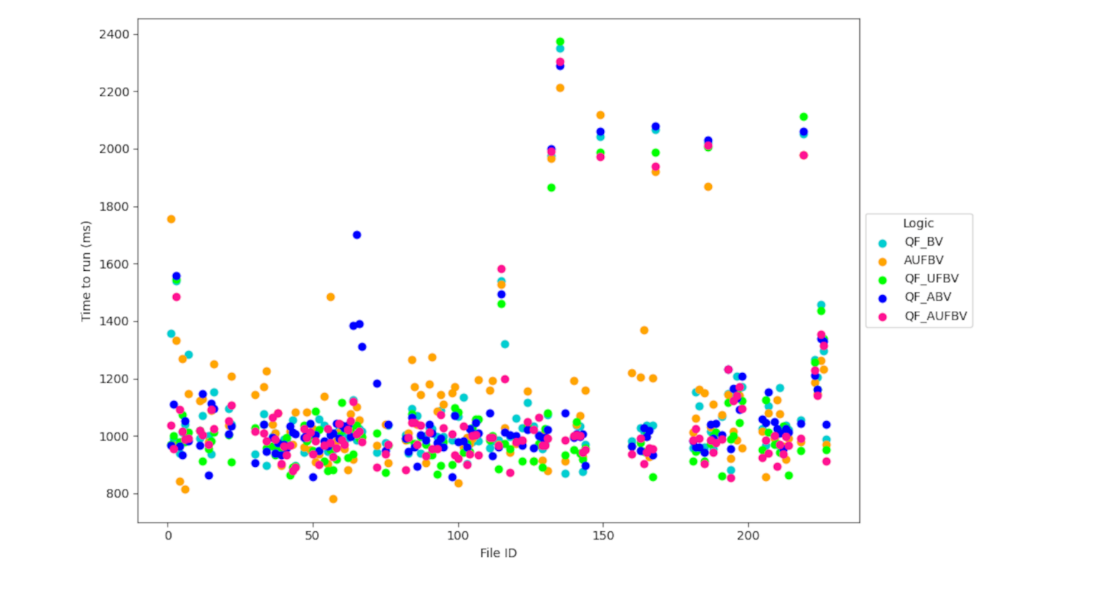
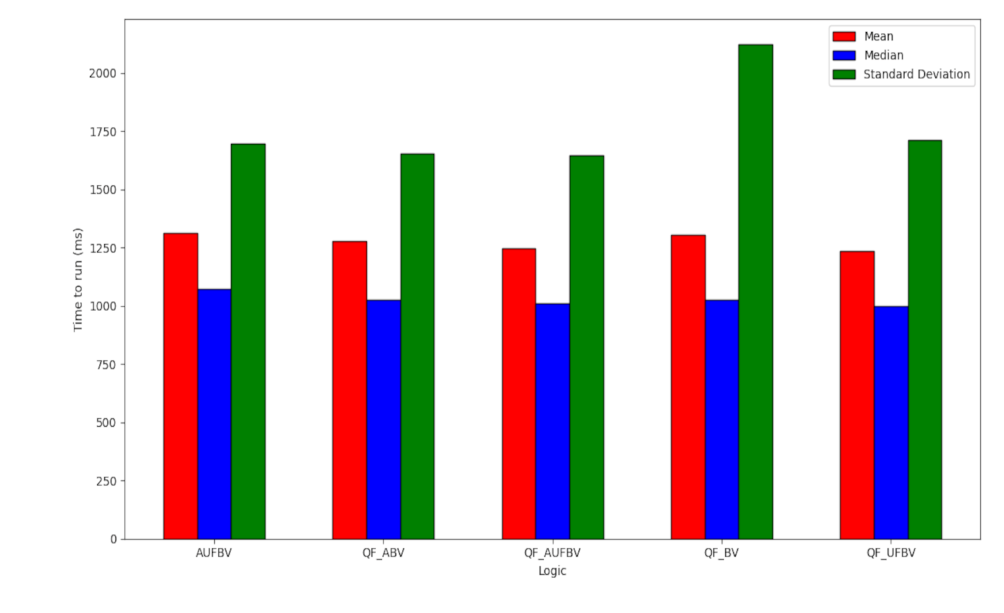
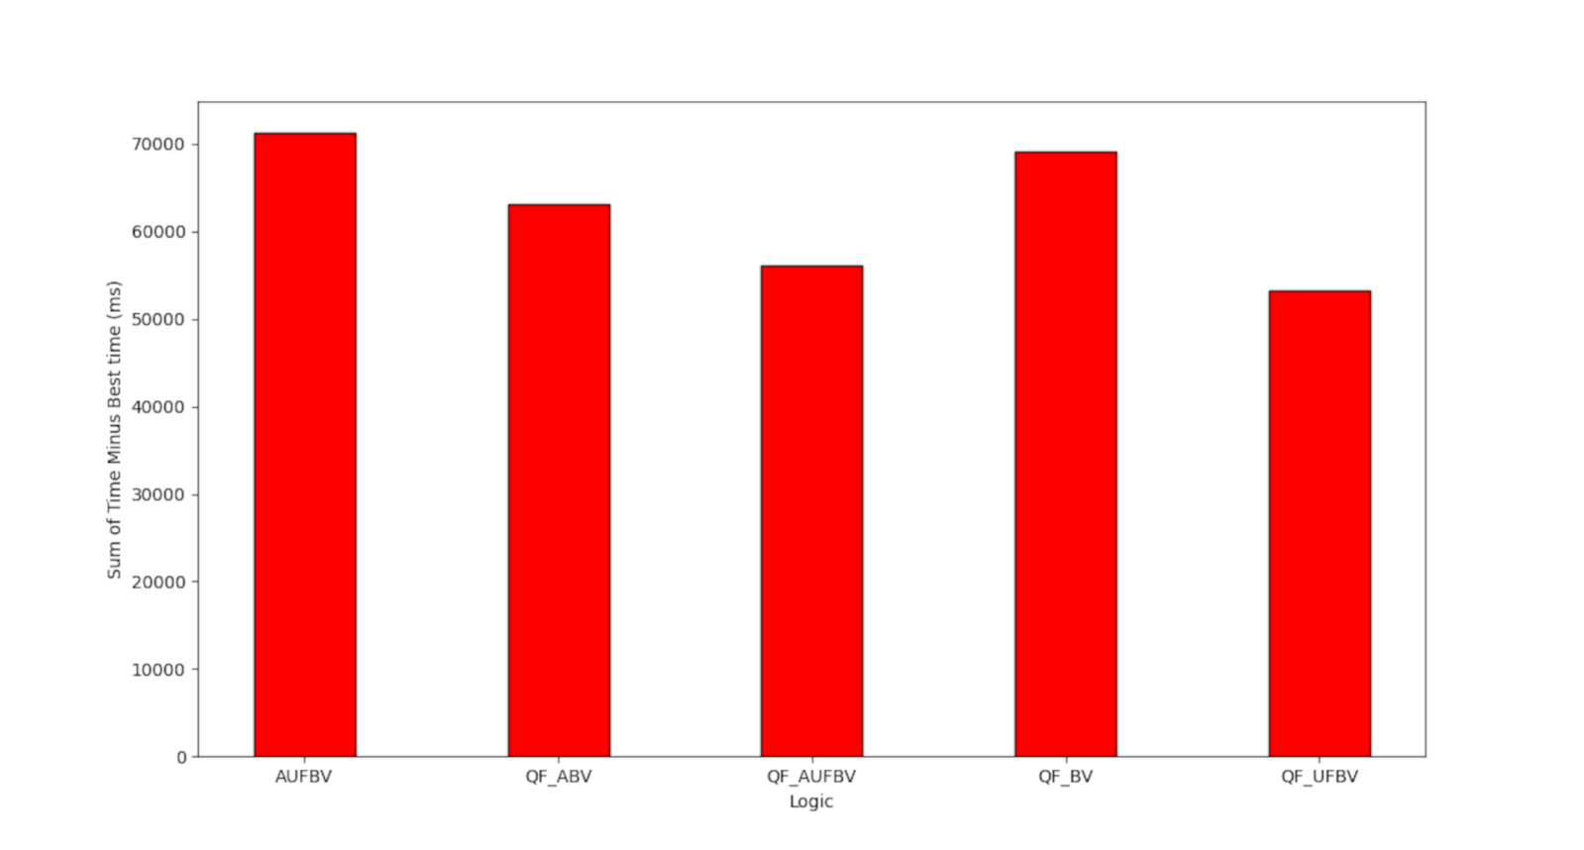
The effects of SAT logics on CUDA kernels
Austin Guiney and Tiago Cogumbreiro
Background
Efficient detection of computer bugs makes software safer and more reliable.
Computer bug detection in GPU programs can be improved by selecting optimal parameters in Faial.
Graphs
Methods
Data was collected by benchmarking the Faial program, which detects computer bugs in CUDA kernels.
Data visualization was used to interpret the data.
Fig 1. Visualization of the raw data that was collected.
Faial guarantees that 206 GPU programs have no bugs in 6 minutes using optimal
parameter selection.
Results
A parameter selection algorithm was developed to minimize Faial’s execution time and improve the accuracy of its bug detection.
The algorithm ranked highly in execution time and accuracy metrics.
Fig 3. Execution time statistics for Faial using different parameters.
Acknowledgements
The work of AG was supported in part by College of Science and Mathematics Dean’s Undergraduate Research Fellowship through fellowship support from Oracle, project ID R20000000025727.
This material is based upon work supported by the National Science Foundation under Grant No. 2204986.
This work was supported in collaboration with the Software Verification Lab.
Fig 4. Total execution time for Faial using different parameters.

